Slide 1
Bangladeshi Festivals
Submitted By:Mst.Farjana Mallik

Slide 2
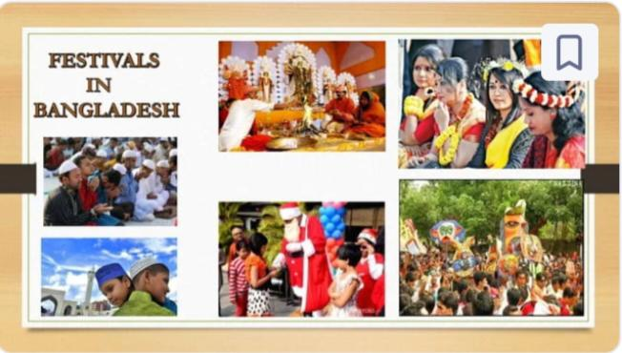
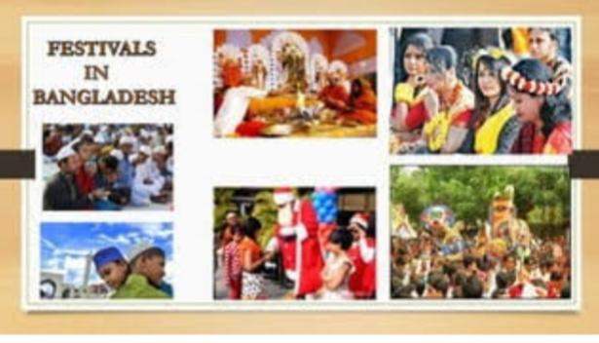

Slide 3
Introduction
First of all I want to say Bangladesh is a land of festival .During whole year here festivals come one after one & all of us enjoy-clebrate that festivals.
One thing is special in Bangladesh .Many of religious festivals are celebrated & those festival celebrated by all the peoples of all religions. There is a verse in Bangla about it-ধর্ম যার যার উৎসব সবার

Slide 4
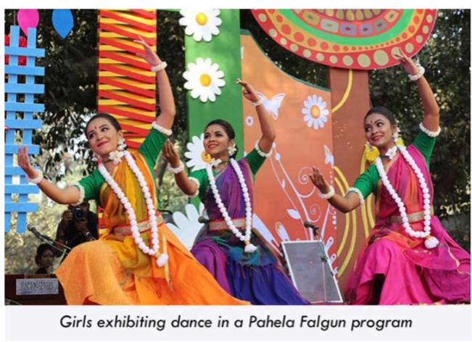
Pahela Falgun

Slide 5
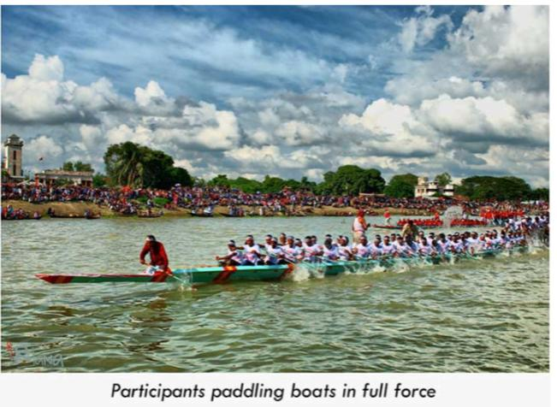
Nauka Baich

Slide 6
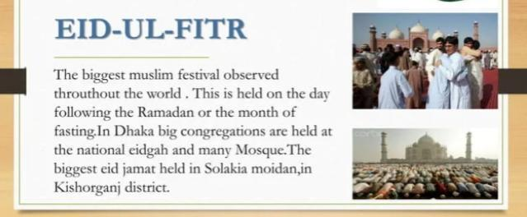

Slide 7
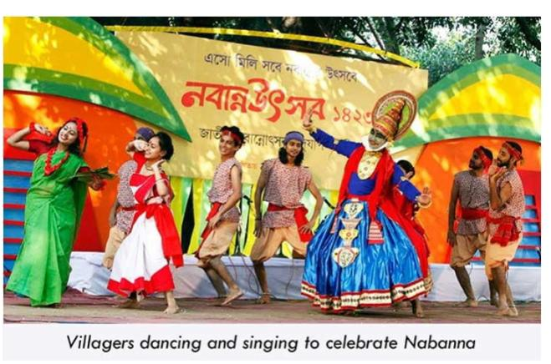
Nabanna Utsab

Slide 8
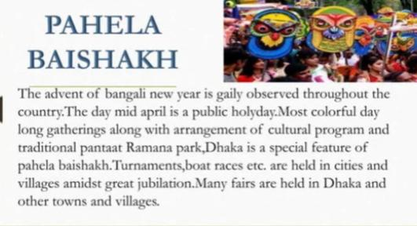

Slide 9
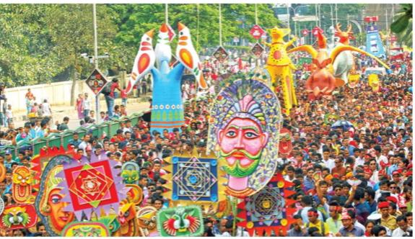
Colourful Durga Puja

Slide 10


